Slide 1

Updated 8/29/24
Notes:
Welcome to the Access to Mental Health Care Tool Kit training. This training was created in collaboration with a small work group that was set forth with identifying items staff could use when providing direct service to clients with mental health concerns or post partum depression. Your agency or program can determine what and if you utilize any of these resources, we just wanted you to know they are available, where to find them, and how to use them.

Slide 2

JUST A REMINDER…
In an emergency, call 9-1-1.
If a mom/client has shared they hare having suicidal thoughts, or has attempted to harm themselves, please have them call or text the National Suicide Prevention Lifeline.
Call or text 988.
ACCESS TO MENTAL HEALTH TOOLKIT

Slide 3





HEALTH PLAN REFERRALS
ACCESS TO MENTAL HEALTH TOOLKIT
Notes:
The Medicaid Managed Care Organizations in Hillsborough County are run by these 5 health plans (Humana, United HealthCare, Aetna, Simply and Sunshine). Through our Central Intake and Referral process at Healthy Start we have begun to automatically receive referrals for women who have applied to their health plan. Additionally, we will begin receiving cases that are identified as needing additional support and these will be call high acuity cases. We are going to walk through each of these health plans. Not to learn about individual services that each one offers, but instead to familiarize yourself with their websites, customer services numbers and their member ID cards. We want to teach the clients how to access their health plan and MCO case managers as services and benefits may change or depend on one’s circumstances that we will not be knowledgeable of.

Slide 4

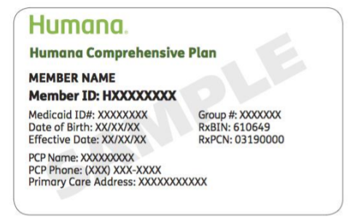
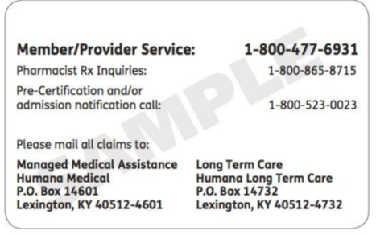
Customer Service:
1-800-477-6931
Behavioral Health:
1-844-265-7590 (TTY: 711)
List of additional Phone Numbers: https://www.humana.com/medicaid/florida-medicaid/member-support/contact-us
Pregnancy services:
1-800-322-2758 ext. 1500290
https://www.humana.com/medicaid/florida-medicaid/member-support/moms-first
ACCESS TO MENTAL HEALTH TOOLKIT

Slide 5

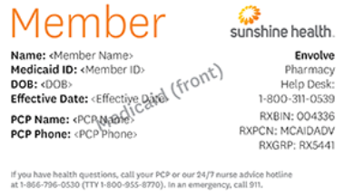
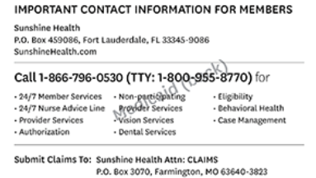
Customer Service:
1-866-796-0530
(TTY 1-800-955-8770)
Behavioral Health:
Looking for providers call 1-844-477-8313
Experiencing a crisis call 24/7: 1-866-796-0530
List of additional Phone Numbers: https://www.sunshinehealth.com/members/medicaid/resources/key-contacts.html
Handbook: https://www.sunshinehealth.com/members/medicaid/resources/handbooks-forms.html
Pregnancy Services:
1-844-477-8313 (opt3, press 1, and extension 603-3883)
https://www.sunshinehealth.com/members/medicaid/benefits-services/pregnancy-and-newborn-services.html
ACCESS TO MENTAL HEALTH TOOLKIT

Slide 6

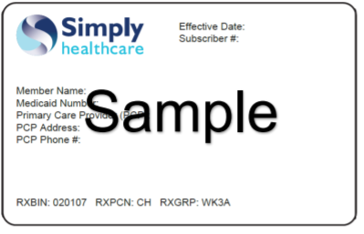
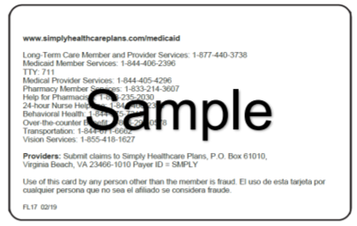
Customer Service & Behavioral Health:
1-844-406-2396 (TTY:771)
1-844-375-7215 (afterhours or weekends)
All Medicaid Benefits listed here with subcategories to click on:
https://www.simplyhealthcareplans.com/florida-medicaid/benefits/medicaid-benefits.html
Pregnancy Services
1-844-405-4296 (Enter NPI number, press 4)
ACCESS TO MENTAL HEALTH TOOLKIT

Slide 7
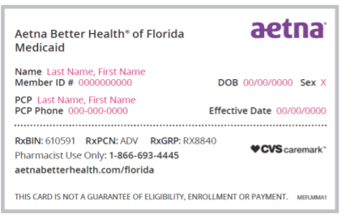
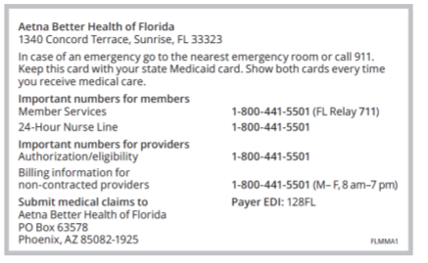
Customer Service:
1-800-441-5501 (TTY:771)
(option 5 for perinatal care support)
Behavioral Health Options:
1-844-513-4954
(option 9 for crisis, 2 for Providers)
All Medicaid Benefits listed here in handbook including additional resources and phone numbers: https://www.aetnabetterhealth.com/florida/members/handbook
ACCESS TO MENTAL HEALTH TOOLKIT

Slide 8
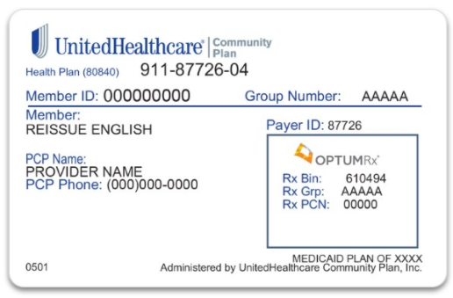
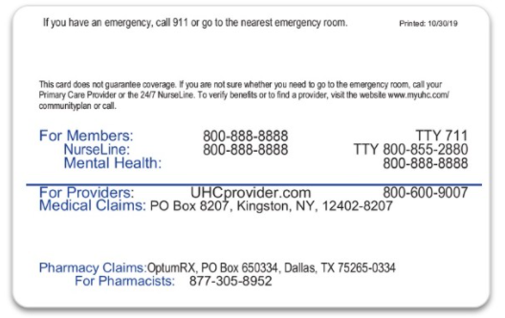
Customer Service:
1-855-356-6098 (TTY:771)
Behavioral Health:
1-877-711-3662
Crisis text line: Text “Home” to 741741
List of additional Phone Numbers: https://www.uhc.com/member-resources/health-care-programs
Pregnancy Services:
1-800-599-5985
https://www.uhcprovider.com/en/resource-library/maternity-support.html
ACCESS TO MENTAL HEALTH TOOLKIT

Slide 9
No Medicaid benefits yet?
Apply for assistance or check the status of your application at the Florida Department of Children and Families’ ACCESS Florida website
myflorida.com/accessflorida
1-866-762-2237
*Recommendation: Obtain confirmation of pregnancy at first OB appointment
ACCESS TO MENTAL HEALTH TOOLKIT

Slide 10

Need help applying for coverage?
Helps connect adults and children to no/low cost coverage through:
  Health Insurance Marketplace
  Florida Medicaid
  Hillsborough County Health Plans
  Medikids
  Florida Healthy Kids
  Children's Medical Services (CMS)
Phone:
813-995-7005
Website: www.familyhealthcarefdn.org
ACCESS TO MENTAL HEALTH TOOLKIT

Slide 11


ACCESS TO MENTAL HEALTH TOOLKIT

Slide 12
Utilizing insurance
Review plan’s enrollment materials and coverage benefit levels:
Does the individual have a log in for their customer service portal?
  Log in together to do a search of local providers
  Keep in mind providers in-network will be cheaper
  Assist in seeing who has availability
  Review costs and copayments
  Encourage the individual to call and make an appointment
  If there is a wait time, they can seek care at one of our free services while they wait or call their OB/GYN or primary care provider.
Does the individual have a customer service phone number?
  Customer service reps will sometimes email a list of providers when asked.
  Customer service reps can walk the client through how to search online
  They can also explain benefits and cost of in network vs out of network providers.
ACCESS TO MENTAL HEALTH TOOLKIT

Slide 13
Directory Searches
ACCESS TO MENTAL HEALTH TOOLKIT

Slide 14


Text or call help line
Provider search by specific categories and areas
Closed Facebook group
Online support groups by categories and characteristics
Awareness posters
https://www.postpartum.net/get-help/
ACCESS TO MENTAL HEALTH TOOLKIT

Slide 15
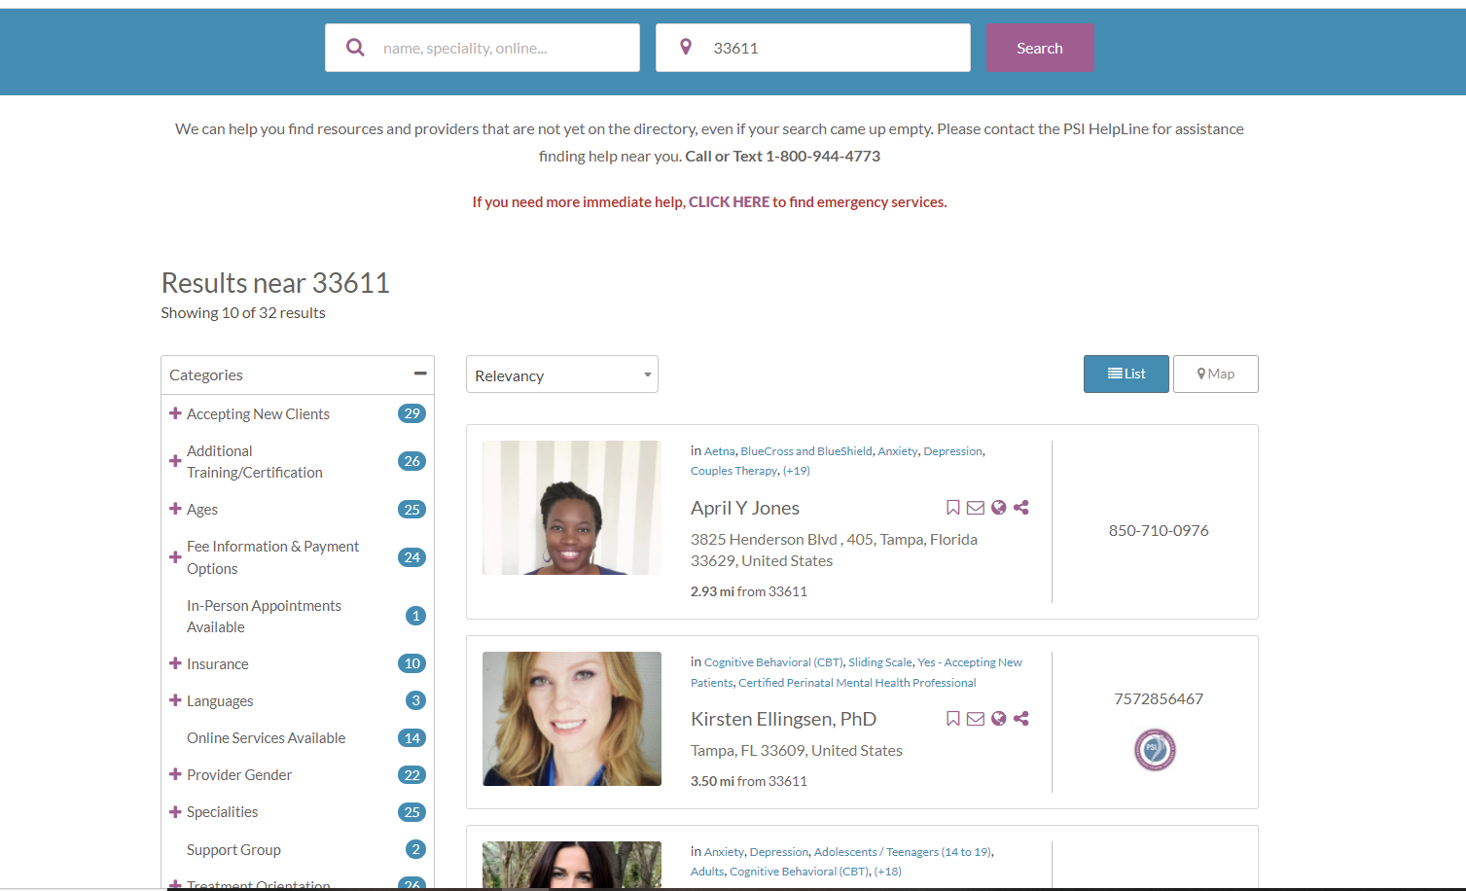
Provider directory:
specializing in ppd
https://psidirectory.com/
ACCESS TO MENTAL HEALTH TOOLKIT

Slide 16

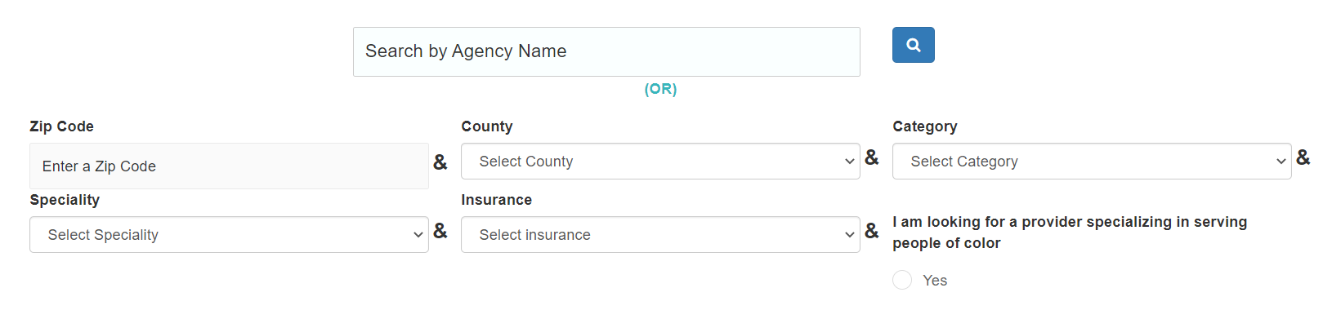
Available services:
Statewide Maternal Mental Health Directory
  By: Agency, Practice Name, Health Care Provider, Geographical Area, Key Words, Zip Codes, and Personalized Care
Self Care Suggestions
Toolkits and Referral Resources for Clinicians
https://flmomsmhresources.org/
ACCESS TO MENTAL HEALTH TOOLKIT

Slide 17
Direct Services
ACCESS TO MENTAL HEALTH TOOLKIT

Slide 18

Perinatal Support Program: Contact Mary Frances Lowe
Available services:
Support during pregnancy and postpartum
Offers phone support, support groups, and linkage to psychiatry if needed
Offers 12-16 free sessions and teletherapy when needed
Register for support groups here: https://baycare.org/events
County of residence is not a stipulation
Email perinatalsupportservices@BayCare.org
Call 813-872-3925 8:00am-4:00pm Monday through Friday
https://baycare.org/hospitals/st-josephs-womens-hospital/services/maternity/postpartum-support
ACCESS TO MENTAL HEALTH TOOLKIT

Slide 19
Help for Dads
Call or Text our Help Line
  1-800-944-4773 (4PPD) – English and Spanish
Online Dad Support Group
  First Friday at 10:00am ET/7:00am PT
  Third Friday at 8:30pm ET/ 5:30pm PT
Monthly Just for Dads Chat
  https://www.postpartum.net/get-help/chat-with-an-expert-for-dads/
Connect with an experienced dad (Specialized Coordinator) and to access additional resources please utilize this website.
ACCESS TO MENTAL HEALTH TOOLKIT

Slide 20
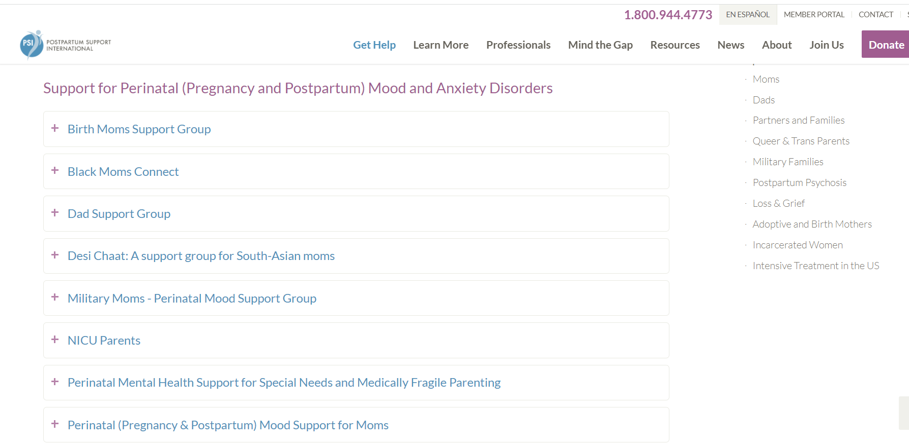
Online Support Meetings
https://www.postpartum.net/get-help/psi-online-support-meetings/
ACCESS TO MENTAL HEALTH TOOLKIT

Slide 21

Only virtual services
Mental health services specializing in women: Anxiety, depression, loss, birth trauma, perinatal, parenting, reproductive health, postpartum depression, menopause, infertility etc.
Therapy, coaching, psychiatry, care navigation team, and medication-assisted treatment services based on needs
Self refer or you can refer the client below
Insurance list: https://hellolunajoy.com/accepted-insurances
https://hellolunajoy.com/general-referral
ACCESS TO MENTAL HEALTH TOOLKIT

Slide 22

Serves individuals 11-38 years old
Virtual evidence based intensive outpatient program: 11 hours of therapy a week for 8-12 weeks, tailored treatment plans including curated group cohorts, individual and family therapy
Newly Launched Maternal Mental Health (no age limit)
No waitlists
Accepts most major forms of insurance including Commercial health plans, Medicaid (Aetna Better Health, Humana, Molina, Simply, and Sunshine) and TriCare.
Referrals: email Maggie.dean@charliehealth.com or call 656-246-5349
https://www.charliehealth.com/
ACCESS TO MENTAL HEALTH TOOLKIT

Slide 23

Sliding scale services
Therapy, counseling, psychiatric and medication-assisted treatment services based on needs
Outpatient, individual sessions, in-person or via telehealth
Walk-in evaluations Monday through Friday 7:30am-3:00pm
Need ID, proof of insurance and proof of income
https://www.covebh.org/mental-health/
ACCESS TO MENTAL HEALTH TOOLKIT

Slide 24

Telehealth therapy and psychiatry, medication management, support to adults over 18 years old.
Flexible with evenings and weekend appointments available.
Accepts both in network and out of network insurance/
  Aetna, Aetna Medicaid, Ambetter, Beacon, Cigna, Coventry, Molina, Simply, Humana Medicaid, Sunshine Health, TRICARE, WellCare, and United.
https://bebravehealth.com/
ACCESS TO MENTAL HEALTH TOOLKIT

Slide 25

Counseling and case management
24/7 client crisis response
CALL 813-443-4827, option 1 for intake
https://www.chrysalishealth.com/mental-health
ACCESS TO MENTAL HEALTH TOOLKIT

Slide 26

Currently only accepting Medicaid as of 01/2022
Telehealth (video conference) Outpatients including individuals, family, medication management, psychiatric evaluations and treatment.
Individuals or family members can refer someone on their website or they can call their phone number.
Flyer on next pages
https://www.impowerfl.org/programs-and-services/telehealth/
ACCESS TO MENTAL HEALTH TOOLKIT
Notes:
IM Power is a nonprofit offering outpatient behavioral health services. This is conducted through video conferences that can include individuals, family, medication management, psychiatric evaluations and treatment. Here is the link and the flyer is on the next page.

Slide 27
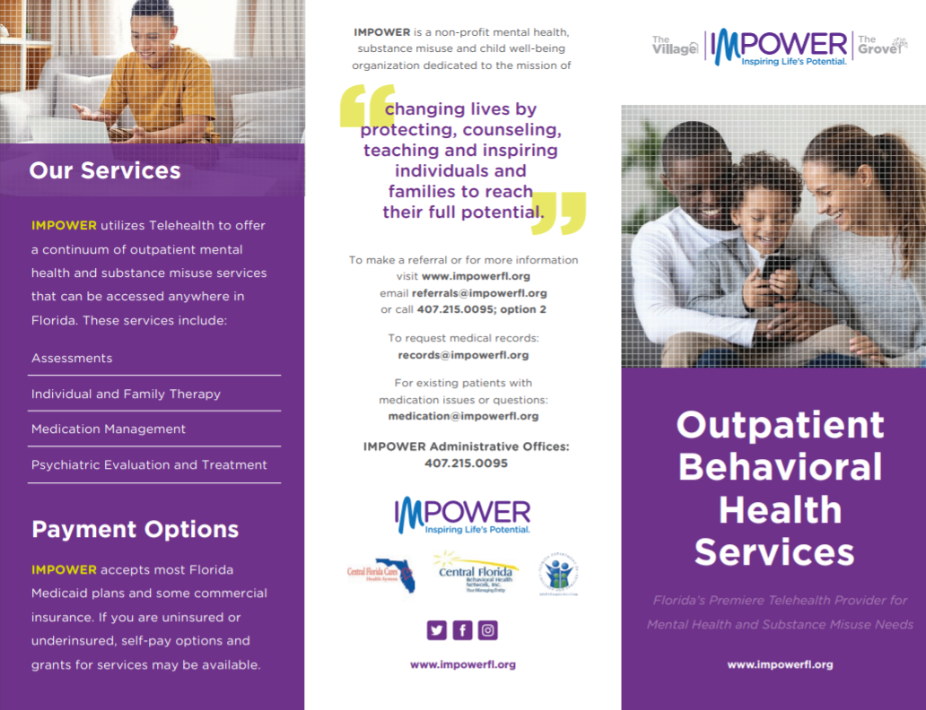
ACCESS TO MENTAL HEALTH TOOLKIT

Slide 28
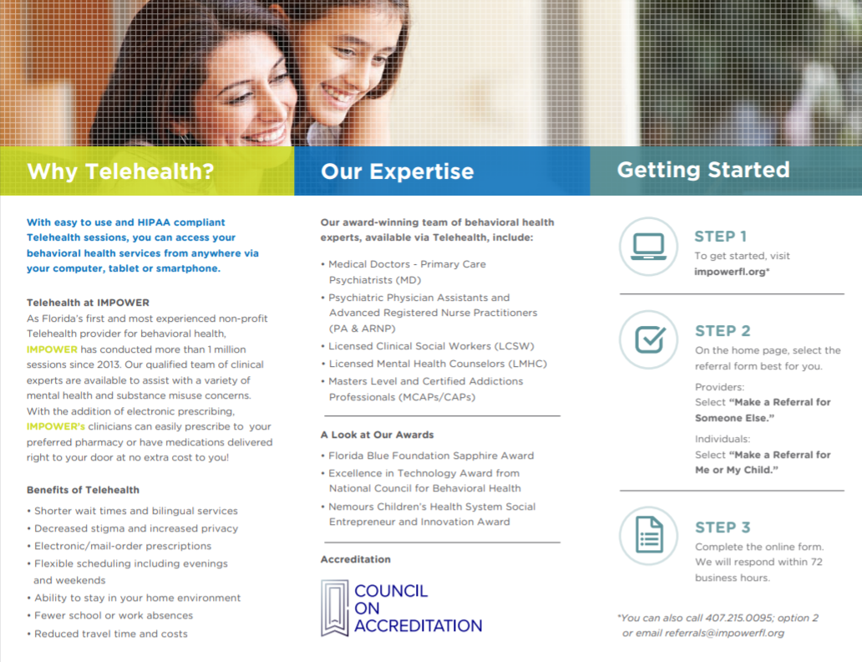
ACCESS TO MENTAL HEALTH TOOLKIT

Slide 29

Inpatient, Outpatient, Addiction, Geriatric and Adolescent services
Walk-ins welcome 24/7
Can call for free insurance verifications or review those accepted here https://www.northtampabehavioralhealth.com/admissions/insurance-payment/
https://www.northtampabehavioralhealth.com/
ACCESS TO MENTAL HEALTH TOOLKIT

Slide 30

Emergency services (adult and children), outpatient behavioral health services (adult and children)
Psychologist, psychiatrists, clinic social workers, licensed mental health counselors, and credentialed alcohol or substance use counselors
Bilingual services available
Private Insurance, Medicaid, Medicare, and Hillsborough County Health Care Plan
Walkins welcome,
Crisis care call 813-272-2958
Outpatient location is 5707 N. 22nd St., Tampa, FL 33610.
GracepointWellness | Family Medicine & Mental Health | Crisis | Florida
ACCESS TO MENTAL HEALTH TOOLKIT

Slide 31

Mental health Inpatient and outpatient services: counseling, case management, Baker Act-Receiving Facilities, substance use
  Secure residential program for youth 11-18yo
Available to any person adult or child
Pharmacy services
Make an appointment at 877-850-9613
Behavioral Health Services (baycare.org)
Baker Act Receiving Facilitates: Baker Act-Receiving Facilities (baycare.org)
ACCESS TO MENTAL HEALTH TOOLKIT

Slide 32
Mental Health Resources
ACCESS TO MENTAL HEALTH TOOLKIT

Slide 33
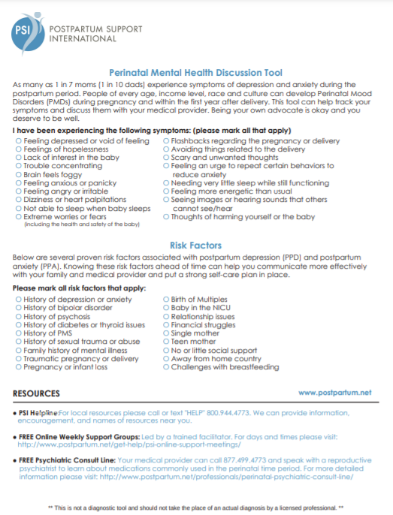
PSI Mental health
Discussion tool
ACCESS TO MENTAL HEALTH TOOLKIT
Notes:
Lastly, I want to point out the PSI Mental Health Discussion tool. For programs who do not use the Edinburgh this may be helpful in guiding someone to seek support. This tool highlights signs and symptoms that individuals should discuss with their health care provider. Addition, it highlights risk factors, resources, and could be used to know when to refer someone for assistance.
I know many agencies are using a mental health screening tool such as the Edinburgh. This would not be recommended as it would be unnecessary.

Slide 34

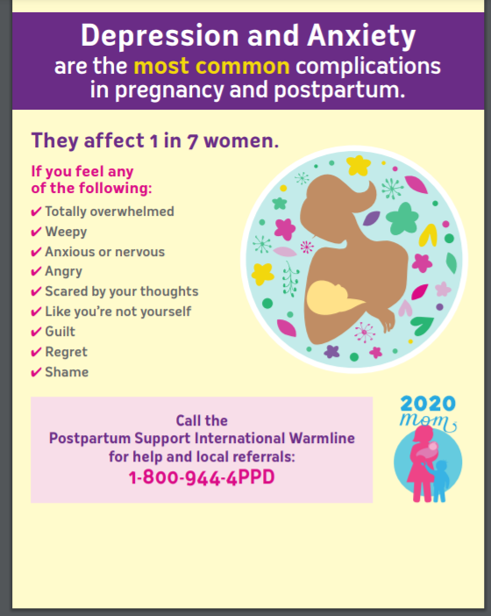
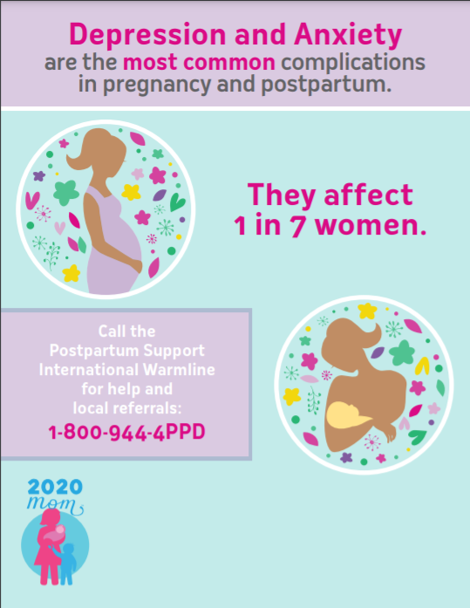
WWW.2020MOM.ORG
ACCESS TO MENTAL HEALTH TOOLKIT
Notes:
Lastly, I wanted to bring 2020 Mom to your attention. This is a great resource for Awareness flyers. 2020 mom is a nonprofit that provides trainings/webinars, is doing research on peer support specialist for mental health care, and has nice newsletters that you can sign up for. These awareness flyers can be ordered or downloaded. You can even add your own logo to these for distribution. You can check out their website at 2020mom.org

Slide 35


Mental Health first Aid training
HTTPS://CFTAMPABAY.ORG/MENTALHEALTH
ACCESS TO MENTAL HEALTH TOOLKIT
Notes:
The Community Foundation of Tampa Bay is providing free mental health first aid training to 5,000 personnel in the nonprofit community. This is taking place over 3 years so if you or your staff have not taken this, this is a great option to know of signs and symptoms, how to seek help, and to increase one’s overall mental health awareness.

Slide 36
Perinatal Loss Direct Services
ACCESS TO MENTAL HEALTH TOOLKIT

Slide 37


Healthy Start Flyer Perinatal Loss
ACCESS TO MENTAL HEALTH TOOLKIT

Slide 38

Services for women who do not want Healthy Start care coordination services, but need support for a miscarriage, fetal, or infant loss.
Referral Process
Session Information
Email referral form to: JeanetteWorrell@empathhealth.org
Referral can also be made via phone at 727-523-3451
Local referral form can be provided
Consent to exchange information will be obtained from Empath for collaboration purposes
Five, 1-hour sessions
Attendees determined by family
Virtual or face-to-face at Mary Lee’s House
Sessions cost $20 per hour for the client after the initial sessions have ended
ACCESS TO MENTAL HEALTH TOOLKIT
Notes:
Empath health works in partnership with Healthy Start to provide mental health counseling to women who decide not to enroll in Healthy Start Services. These families can receive services with any other home visiting program in the county. This is because HS can offer mental health counseling for our clients, and did not want these women to go without support therefore this partnership was created. Here women who have experienced a miscarriage, fetal or infant loss can receive up to 5 one hour sessions for free. After the 5 sessions, each additional session is $20 per hour. Services are offered either virtual or face to face at Mary Lee’s House and attendees are determined by the family.
If you would like to refer clients to Jeanette Worrell JeanetteWorrell@empathhealth.org. Healthy Start does have a referral form and can provide that if you reach out to me directly. Empath is happy to collect exchange of information if you would like to collaborate on the specific client.

Slide 39

Lifepath Hospice
Self referral at 813-877-2200
No cost to client
Services include:
  One-on-one counseling for bereavement,
  A child loss group meeting.
https://www.chaptershealth.org/
ACCESS TO MENTAL HEALTH TOOLKIT

Slide 40

813-501-9567 Debbie Nemitz
Informal, self-help group meetings
  New Hope United Methodist in Brandon, FL:
    Day: Second Friday of each month 10:00am – 12:00pm
    Evening: Last Thursday of each month 6:30pm – 8:30pm
    St Joe’s Hospital:
      Medical Arts Building Auditorium
      Second Sunday of each month 6:30pm-830pm
Families are welcome to bring support persons.
www.bereavedparentsusa.org/chapters/find-a-chapter/
http://www.bpusatampabay.com/
ACCESS TO MENTAL HEALTH TOOLKIT
Notes:
Bereaved Parents of Tampa Bay is a local chapter of a national organization. Debbie is the main contact that can answer any questions you have. She is very nice and can help navigate or answer questions about the group meetings They have two face to face locations. One at New Hope United Methodist in Brandon Florida. Here they meet twice a month (one day time and one evening hours). Then they also meet at St Joes Hospital in the evening on the weekend. Debbie did say that during covid they will be providing support groups virtually but I do not have the dates and times for this. Lastly, clients can look on their websites for special events that may arise to remember those that have been lost.

Slide 41

Ronald McDonald House Charities continues the work of High Risk Hope as of May 1st 2023.
Email contact: aalexander@rmhctampabay.org
Phone number: 813-258-6430
Operating at SJWH, TGH, JHACH, Sarasota Memorial, and Mease.
Delivers NICU support for caregivers by providing items for hygiene, self-care, books, journals, etc.
Limited temporary housing while baby is in NICU, must have permanent housing to be eligible
https://rmhctampabay.org/hope-continues/
ACCESS TO MENTAL HEALTH TOOLKIT

Slide 42
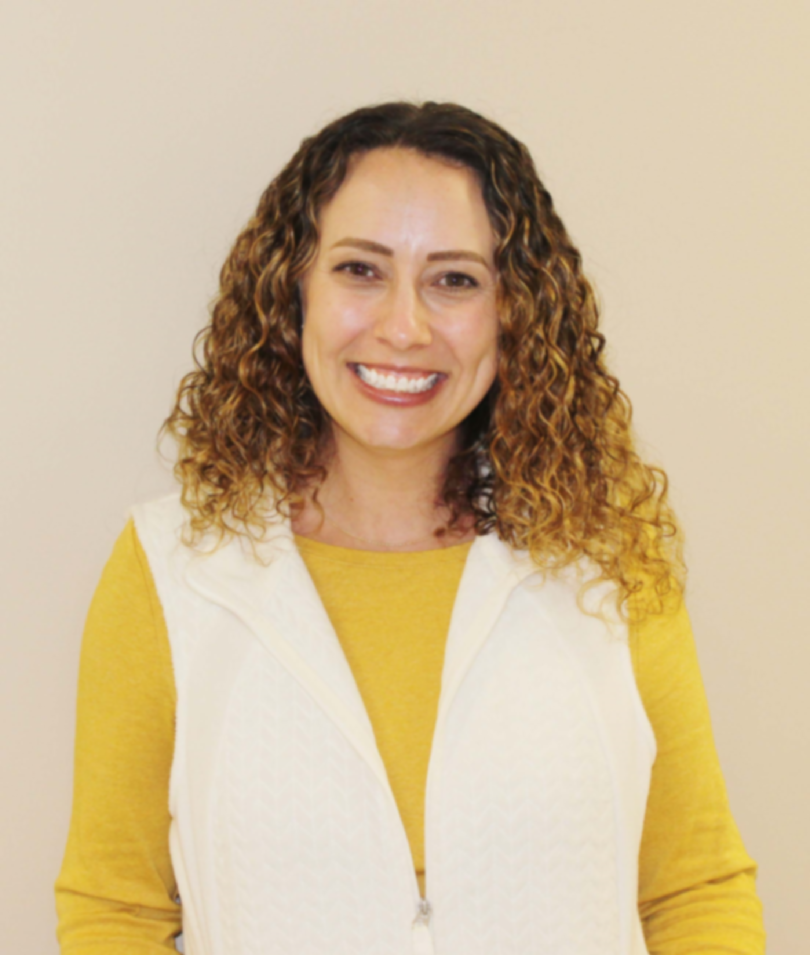


Questions or concerns?
Cherith Belmonte
Manager of Programs and Quality Improvement
cbelmonte@hstart.org
ACCESS TO MENTAL HEALTH TOOLKIT
Notes:
Though there are many resources in the community for both post partum depression and perinatal loss this sums up the one’s we wanted to highlight. Thank you for your time and if you have any questions please reach out.

